Slide 1

Future
3.0

Slide 2



Youth policy
a purposeful and coordinated activity in different spheres of life that proceeds from the actual needs and challenges of young people, or unified approach to all activities targeted at young people in all areas concerning their life.
In Europe: White Paper on youth, 1999
In Estonia: 2006-2013, new period 2014-2020

Slide 3

Priorities of youth policy
the participation of the young in society, especially through youth organisations and an intensified co-operation with all partners in the youth field;
equal opportunities of access for the young particularly regarding mobility and youth information;
regular interest in the social situation of the young in Europe – promotion of a global and integrated youth policy.

Slide 4
Main fields of youth policy (Bucharest conference 1998)
– participation and citizenship;
– fighting social exclusion;
– non-formal education,
with the topic of access to the labour market running through all these fields

Slide 5
Youth policy: Estonia
New 2014-2020 vs old 2006-2013
Integrated youth work: coordinated and purposeful activities concerning the life of a young person (young → education → employment → health → other activities)

Slide 6
Youth policy: “package of experience”
participation opportunities and experience
studying
creativity and possibility of self-expression
information and guidance
experience in social membership
safety and welfare
prevention of problems and support in dealing with them

Slide 7
Youth policy 2020: theory of strategic development
Occasional YW
Conscious integrated YW
Area policies and measures target youth also and up to some level
Youth is attributed to one or another target group (student, NEET, poverty etc)
Area policies and measures are developed considering needs of youth
Measures defines by youth problems, not vice versa

Slide 8
Youth policy 2020: impact on youth
Occasional YW
Conscious integrated YW
Young becomes passive (consumer attitudes, helplessness and adaptive options)
Success or failure is cluster recognition feature (eg, failure in studies = difficulties at work = lower quality of life).
Apathy and self-destruction when no solution is found
Extreme outfit as disregard of self and surroundings
Lack of confidence in itself and the country.
Active youngster with forward-believing attitude in life, knows how to create a real choice of your life, what is the reason to keep valuable.
Young is a critical thinker, entrepreneurial leader who sees challenges and create solutions to problems.
Membership in a community provides an opportunity to be successful for the people around

Slide 9
Youth policy 2020: impact on state
Occasional YW
Conscious integrated YW
Increasing need for "care services”
Low social mobility, ie stratification of the problems / groups concern are recurrent and worsening.
Low citizens activity
Success-based demographics – support and recognition is given exclusively
Public administration is entrepreneurship and innovation oriented
Low level of drop-outs and social mobility
Supportive environment, society
Generous living environment, family values

Slide 10
Youth policy 2020: four focus areas
Creativity and potential
Equality
Unemployment
Active citizenship

Slide 11
Youth field as support to unemployment strategy
Youth labor market challenges for the EU:
  Early school leaving qualification without qualifications
  The lack of relevant skills and experience
  Insecure employment, followed by short periods of unemployment
  limited training opportunities
  Insufficient / inappropriate social programmes
Notes:
In 2012, the EU has 5.520 million young unemployed people (under 25 years). The youth unemployment rate is about 2 times higher than the total working population (10.6) and 3 times higher than in the adult population of the active case. In some countries, the youth unemployment rate of over 50%. In EE in 2012 the youth unemployment rate to 19.5%.

Slide 12
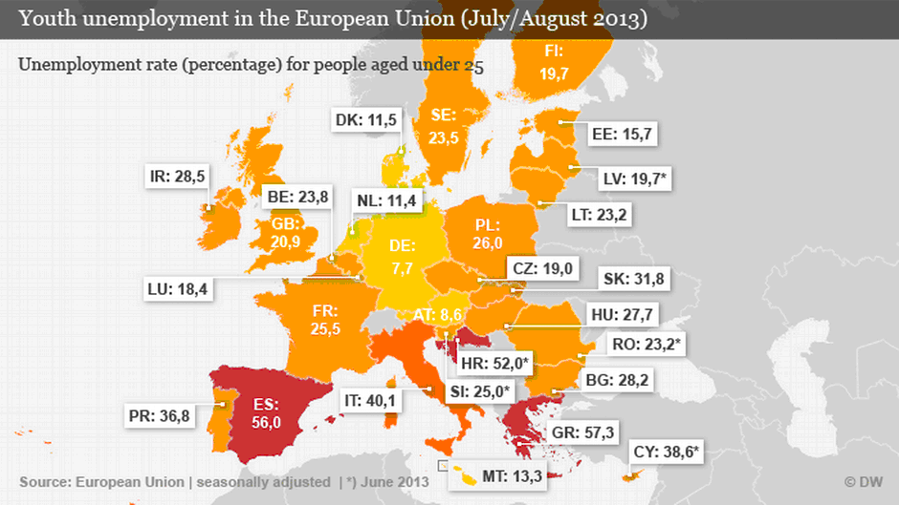
Unemployment in the EU
Notes:
“in 2012. aasta septembris oli Euroopa Liidu liikmesriikides kokku 5,520 miljonit noort töötut (alla 25-aastased). Noorte töötuse tase on ca kaks korda kõrgem kui kogu töötava elanikkonna (10,6) ning kolm korda kõrgem kui täiskasvanud aktiivse elanikkonna puhul. Mõnes riigis on noorte töötuse määr üle 50%14. Eestis langes 2012 III kvartalis noorte töötuse määr 19.5%-ni.”

Slide 13
Unemployment in Estonia
Notes:
“2012. aasta septembris oli Euroopa Liidu liikmesriikides kokku 5,520 miljonit noort töötut (alla 25-aastased). Noorte töötuse tase on ca kaks korda kõrgem kui kogu töötava elanikkonna (10,6) ning kolm korda kõrgem kui täiskasvanud aktiivse elanikkonna puhul. Mõnes riigis on noorte töötuse määr üle 50%14. Eestis langes 2012 III kvartalis noorte töötuse määr 19.5%-ni.”

Slide 14
Challenges to face
According to Eurostat population projections, the share of young people in the total population is expected to fall in the years up to 2060
If the decline is not reversed, the youth population of the European Union could fall by a further 14 million in the next 50 years
Youth unemployment (Greece 58,4%)
Multy culty
Migration
Digital era
Fight against poverty
Generation NEET

Slide 15
Estonia: country specific issues
  Very high drop-out rates, as result men’s education level is much lower than women’s
  Unemployment of non-Estonian youth is two times higher, than Estonian youth unemployment
  The annual cost of NEET one of the highest in EU (1.5% of GDP)
  Unemployment and lack of work force at the same time

Slide 16
Education as a promoter of social mobility
Education as promoter of mobility and unemployment → system → competence based learning, diversified education
Challenges:
  Only in higher education under internationalization strategy
  Extensive reforms of the primary and secondary education
  Demographic changes
Notes:
In modern societies, education is seen as the most important determinant of social position as well as a prerequisite for social mobility, avoiding unemployment, etc. The extent and particular nature of its effect (to what degree it promotes or reduces inequality) depends on the organization of the education system.
“Today only approximately 3% of Estonian university students spend some time studying abroad. The target set in the European Higher Education Area is for 20% of graduates to have mobility experience by 2020.

Slide 17
Education as a promoter of social mobility
Diversified education (non-formal learning and formal education)
  77% - job chances have increased and helped with making decisions about their future careers;
  65% - clearer ideas about their further educational pathways;
  72% - clearer ideas about their professional career aspirations and goals
Improvements in:
  80% - social skills (cooperation, negotiation, getting along with people of different cultural backgrounds, expressing ideas in discussions, communicating in a foreign language)
  76% - plan to go abroad to study, work or do an apprenticeship
  90% - plan to improve their language skills in the future”
  (Murakas et al, 2010)
Notes:
In modern societies, education is seen as the most important determinant of social position as well as a prerequisite for social mobility, avoiding unemployment, etc. The extent and particular nature of its effect (to what degree it promotes or reduces inequality) depends on the organization of the education system.
“Today only approximately 3% of Estonian university students spend some time studying abroad. The target set in the European Higher Education Area is for 20% of graduates to have mobility experience by 2020.

Slide 18
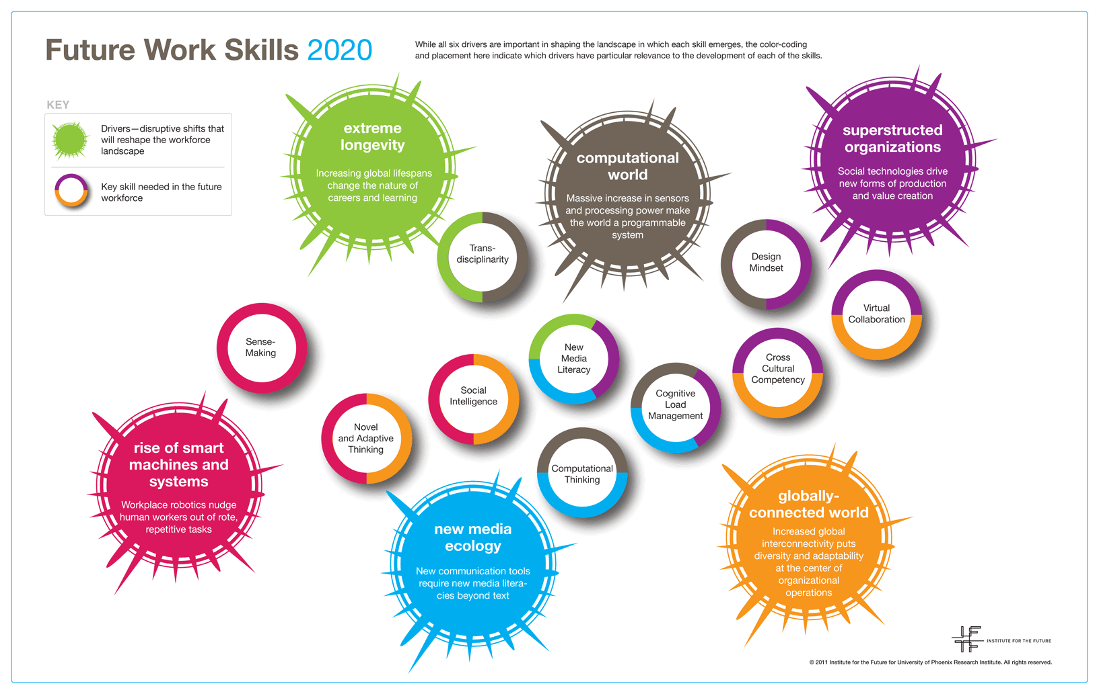
Future work competences 2020

Slide 19
Mobility in education
Erasmus and Erasmus+
Non-formal mobility (often YiA programme)
EVS
Social mobility programmes
Notes:
Erasmus, non-formal mobility (often YiA programme), EVS – Europe spent billions on youth and giving the opportunity to various forms of education mobility.

Slide 20
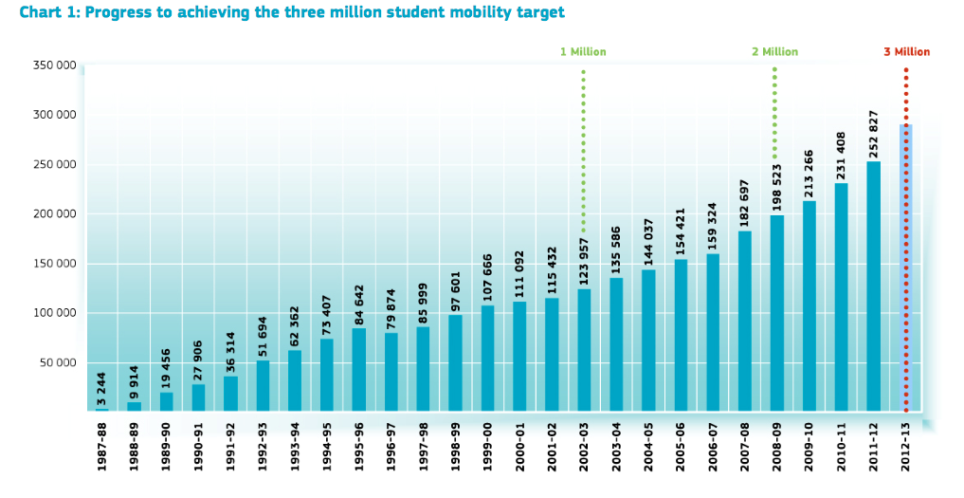
Overview of student mobility
Notes:
Erasmus, non-formal mobility (often YiA programme), EVS – Europe spent billions on youth and giving the opportunity to various forms of education mobility.

Slide 21
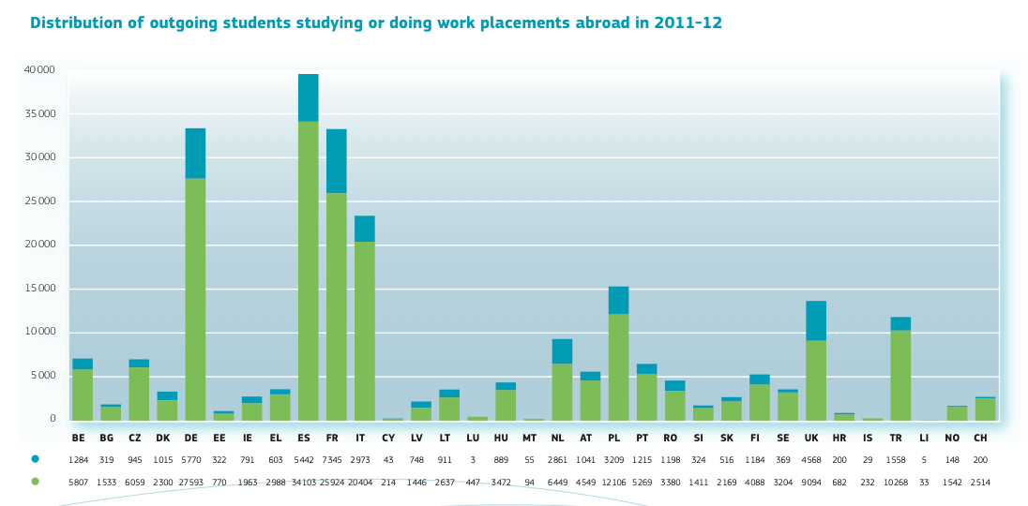
Overview of student mobility
Notes:
Erasmus, non-formal mobility (often YiA programme), EVS – Europe spent billions on youth and giving the opportunity to various forms of education mobility.

Slide 22
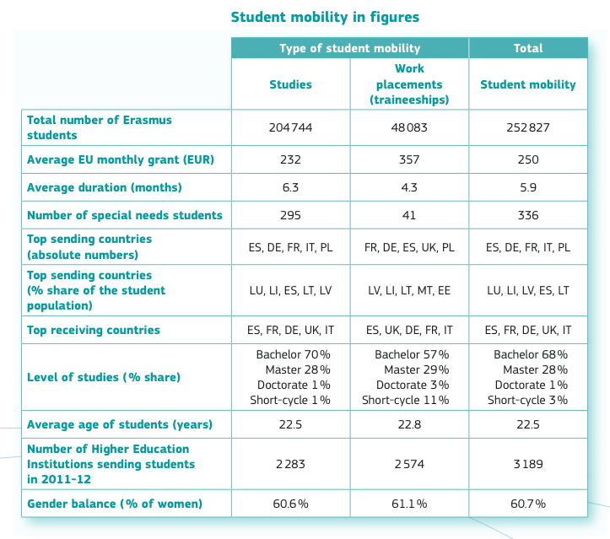
Student mobility in figures (2011-2013)
Notes:
Erasmus, non-formal mobility (often YiA programme), EVS – Europe spent billions on youth and giving the opportunity to various forms of education mobility.

Slide 23
Erasmus+ strategy
Tertiary level attainment:
  Increase - 40% of 30-34 year olds HE graduates
Early School leaving:
  Decrease - 10% of 18-24 year olds not enrolled
Employability:
  Increase - 82% of graduates (20-34 year old) being employed no more than 3 years after they have completed
  education
Notes:
“The enlargement of the European Union has increased the potential for mobility in education and training, as well as in the labour market, thereby creating the need to prepare EU citizens to develop their learning and professional pathways in a broader geographical context…Today, learning mobility is already recognised as an important way in which young people can strengthen their future employability”

Slide 24
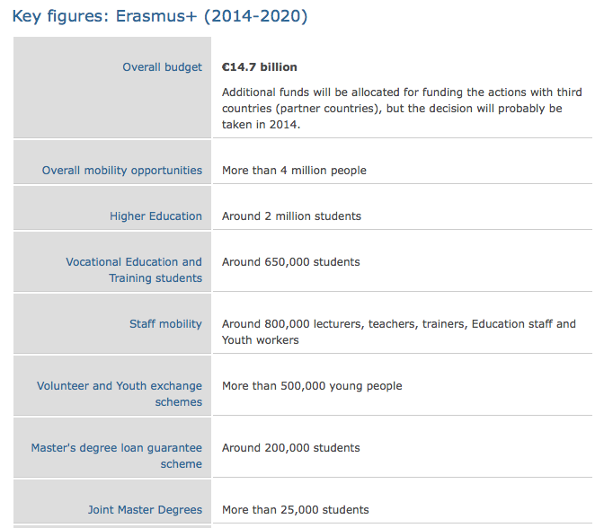
Erasmus+ strategy
Notes:
“The enlargement of the European Union has increased the potential for mobility in education and training, as well as in the labour market, thereby creating the need to prepare EU citizens to develop their learning and professional pathways in a broader geographical context…Today, learning mobility is already recognised as an important way in which young people can strengthen their future employability”

Slide 25
Erasmus+ & widening access
Better linguistic preparation of mobile participants
More support to participants from lower socio-economic background, disadvantaged groups
More flexibility to various needs
New forms of mobility (blended: physical + virtual)
Better use of new technologies
Notes:
“The enlargement of the European Union has increased the potential for mobility in education and training, as well as in the labour market, thereby creating the need to prepare EU citizens to develop their learning and professional pathways in a broader geographical context…Today, learning mobility is already recognised as an important way in which young people can strengthen their future employability”

Slide 26

Olga Bogdanova
Lossi 36, 51003, Tartu, Estonia
Telephone: 737 6375, 56656776
E-mail: olga.bogdanova@ut.ee

